Slide 1
Cellular Communication

Slide 2
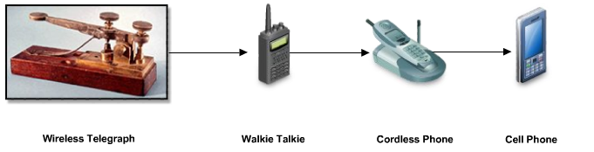
Evolution to cellular networks – communication anytime, anywhere
radio communication was invented by Nikola Tesla and Guglielmo Marconi: in 1893, Nikola Tesla made the first public demonstration of wireless (radio) telegraphy; Guglielmo Marconi conducted long ditance (over see) telegraphy 1897
in 1940 the first walkie-talkie was used by the US military
in 1947, John Bardeen and Walter Brattain from AT&T’s Bell Labs invented the transistor (semiconductor device used to amplify and switch electronic signals)
AT&T introduced commercial radio comm.: car phone – two way radio link to the local phone network
in 1979 the first commercial cellular phone service was launched by the Nordic Mobile Telephone (in Finland, Sweden, Norway, Denmark).

Slide 3
Cellular systems generations
1G (first generation) – voice-oriented systems based on analog technology; ex.: Advanced Mobile Phone Systems (AMPS) and cordless systems
2G (second generation) - voice-oriented systems based on digital technology; more efficient and used less spectrum than 1G; ex.: Global System for Mobile (GSM) and US Time Division Multiple Access (US-TDMA)
3G (third generation) – high-speed voice-oriented systems integrated with data services; ex.: General Packet Radio Service (GPRS), Code Division Multiple Access (CDMA)
4G (fourth generation) – based only on Internet protocol networks, provides voice, data and multimedia service to subscribers (1Gbps for low mobility and 100 Mbps for high mobility)

Slide 4
Frequency reuse
is a method used by service providers to improve the efficiency of a cellular network and to serve millions of subscribers using a limited radio spectrum
is based on the fact that after a distance a radio wave gets attenuated and the signal falls bellow a point where it can no longer be used or cause any interference
a transmitter transmitting in a specific frequency range will have only a limited coverage area
beyond this coverage area, that frequency can be reused by another transmitter

Slide 5
Network Cells
the entire network coverage area is divided into cells based on the principle of frequency reuse
a cell = basic geographical unit of a cellular network; is the area around an antenna where a specific frequency range is used; is represented graphically as a hexagonal shape, but in reality it is irregular in shape
when a subscriber moves to another cell, the antenna of the new cell takes over the signal transmission
a cluster is a group of adiacent cells, usually 7 cells; no frequency reuse is done within a cluster
the frequency spectrum is divided into subbands and each subband is used within one cell of the cluster
in heavy traffic zones cells are smaller, while in isolated zones cells are larger

Slide 6
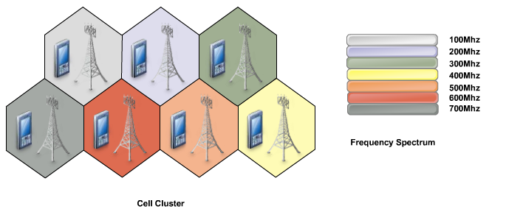
Network cells (2)

Slide 7
Types of cells
macrocell – their coverage is large (aprox. 6 miles in diameter); used in remote areas, high-power transmitters and receivers are used
microcell – their coverage is small (half a mile in diameter) and are used in urban zones; low-powered transmitters and receivers are used to avoid interference with cells in another clusters; especially useful for high frequencies (the antenna size is inversely proportional with the frequency it generates)
picocell – covers areas such as building or a tunnel

Slide 8
Other cellular concepts
handover = moving a call from one zone (from the transmitter-receiver from one zone) to another zone due to subscriber’s mobility
roaming = allowing the subscriber to send/receive calls outside the service provider’s coverage area

Slide 9
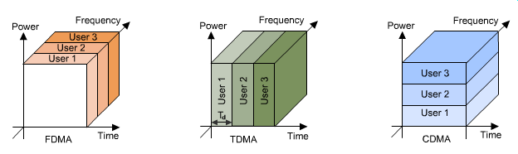
Multiple access schemes
Frequency Division Multiple Access
- when the subscriber enters another cell a unique frequency is assigned to him; used in analog systems
Time Division Multiple Access
- each subscriber is assigned a time slot to send/receive a data burst; is used in digital systems
Code Division Multiple Access
- each subscriber is assigned a code which is used to multiply the signal sent or received by the subscriber

Slide 10
The control channel
this channel is used by a cellular phone to indicate its presence before a frequency/time slot/code is allocated to him

Slide 11
Cellular services
voice communication
Short Messaging Service (SMS)
Multimedia Messaging Service (MMS)
Global Positioning System (GPS)
Wireless Application Protocol (WAP) – to access the Internet

Slide 12
Global System for Mobile Communication (GSM)

Slide 13
GSM characteristics
previous standard in cellular communication were restrictive
GSM – global digital standard for cellular phones that offered roaming facility
first named Groupe Special Mobile and used in Europe; then usage extended to other continents
GSM operate in frequency bands: 900MHz, 1800 MHz, 1900 MHz
GSM provides voice and data services

Slide 14
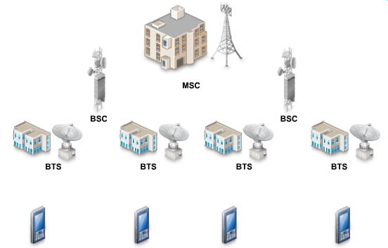
Cellular network components

Slide 15
Cellular network components (2)
BTS (Base Transceiver Station) – main component of a cell and it connects the subscribers to the cellular network; for transmission/reception of information it uses several antennas spread across the cell
BSC (Basic Station Controller) – it is an interface between BTSs and it is linked to BTSs by cable or microwave links; it routes calls between BTSs; it is also connected to the MSC
MSC (Mobile Switching Center) – the coordinator of a cellular network, it is connected to several BSCs, it routes calls between BSCs; links the cellular network with other networks like PSTN through fiber optics, microwave or copper cable

Slide 16






Components of a cellular phone (MSU – Mobile Subscriber Unit)
radio transceiver – low power radio transmitter and receiver
antenna, usually located inside the phone
control circuitry – formats the data sent to and from the BTS; controls signal transmission and reception
man-machine interface – consists from a keypad and a display; is managed by the control circuitry
Subscriber Identity Module (SIM) – integrated circuit card that stores the identity information of subscriber
battery, usually Li-ion, the power unit of the phone

Slide 17
Setting up a call process
when powered on, the phone does not have a frequency/ time slot/code assigned to it yet; so it scans for the control channel of the BTS and picks the strongest signal
then it sends a message (including its identification number) to the BTS to indicate its presence
the BTS sends an acknowledgement message back to the cell phone
the phone then registers with the BTS and informs the BTS of its exact location
after the phone is registered to the BTS, the BTS assigns a channel to the phone and the phone is ready to receive or make calls

Slide 18
Making a call process
the subscriber dials the receiver’s number and sends it to the BTS
the BTS sends to its BSC the ID, location and number of the caller and also the number of the receiver
the BSC forwards this information to its MSC
the MSC routes the call to the receiver’s MSC which is then sent to the receiver’s BSC and then to its BTS
the communication with the receiver’s cell phone is established

Slide 19
Receiving a call process
when the receiver’ phone is in an idle state it listens for the control channel of its BTS
if there is an incoming call the BSC and BTS sends a message to the cells in the area where the receiver’s phone is located
the phone monitors its message and compares the number from the message with its own
if the numbers matches the cell phone sends an acknowledgement to the BTS
after authentication, the communication is established between the caller and the receiver

Slide 20
Subscriber Identity Module (SIM) card
SIM – a memory card (integrated circuit) holding identity information, phone book etc.
GSM system support SIM cards
other systems, like CDMA do not support SIM cards, but have something similar called Re-Usable Identification Module (RUIM)

Slide 21
International Mobile Equipment Identity (IMEI) key
IMEI – a unique 15 digit number identifying each phone, is incorporated in the cellular phone by the manufacturer
IMEI ex.: 994456245689001
when a phone tries to access a network, the service provider verifies its IMEI with a database of stolen phone numbers; if it is found in the database, the service provider denies the connection
the IMEI is located on a white sticker/label under the battery, but it can also be displayed by typing *#06# on the phone

Slide 22
International Mobile Subscriber Identity (IMSI) key
IMSI – a 15-digit unique number provided by the service provider and incorporated in the SIM card which identifies the subscriber
IMSI enables a service provider to link a phone number with a subscriber
first 3 digits of the IMSI are the country code

Slide 23
Temporary Mobile Subscriber Identity (TMSI) key
TMSI – is a temporary number, shorter than the IMSI, assigned by the service provider to the phone on a temporary basis
TMSI key identifies the phone and its owner in the cell it is located; when the phone moves to a different cell it gets a new TMSI key
as TMSI keys are shorter than IMSI keys they are more efficient to send
TMSI key are used for securing GSM networks

Slide 24
GSM architecture

Slide 25
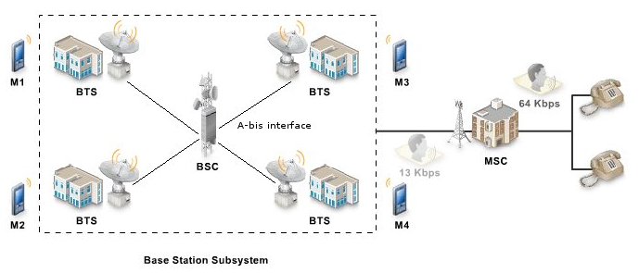
Base Station Subsystem (BSS)

Slide 26
HLR, VLR and EIR registers
Home Location Register (HLR) - is a database maintained by the service provider containing permanent data about each subscriber (i.e. location, activity status, account status, call forwarding preference, caller identification preference)
Visitor Location Register (VLR) – database that stores temporary data about a subscriber; it is kept in the MSC of the of the area the subscriber is located in; when the subscriber moves to a new area the new MSC requests this VLR from the HLR of the old MSC
Equipment Identity Register (EIR) – database located near the MSC and containing information identifying cell phones

Slide 27
Authentication Center (AuC)
1st level security mechanism for a GSM cellular network
is a database that stores the list of authorized subscribers of a GSM network
it is linked to the MSC and checks the identity of each user trying to connect
also provides encryption parameters to secure a call made in the network

Slide 28
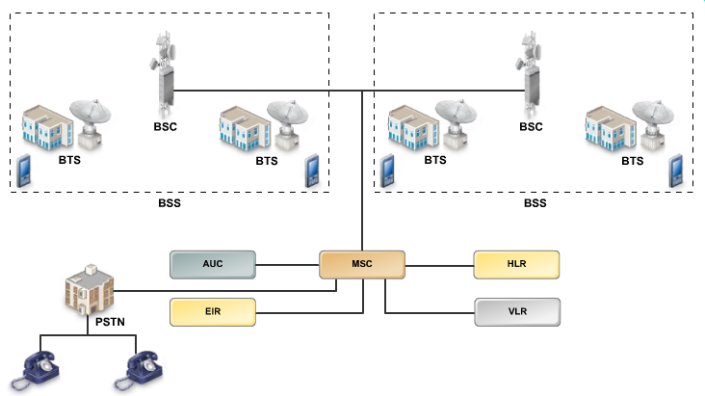
GSM Mobile Switching Center (MSC)
is a switching center of the GSM network; coordinates BSCs linked to it

Slide 29
GSM Channels

Slide 30
GSM channel divisions
the 900MHz frequency band is split into: the 890-915MHz band for the uplink transmission (MS -> BTS) and the 935-960MHz for the downlink transmission (BTS -> MS); 20MHz separation between uplink and downlink
the uplink and downlink bands are further divided into 124 200-KHz subbands using FDMA
each 200-KHz subband is divided into 8 time slots for 8 users using TDMA; each time slot takes 576.92 us; 8 consecutive time slots is called a frame

Slide 31
GSM channel divisions (2)
uplink and downlink take place in different frequency bands and different time slots within a frequency band using FDMA/TDMA
a frame (8 time slots in a specific frequency subband) lasts 4.615ms.
a specific time slot from a specific 200-KHz subband is called a physical channel
26 frames form a multiframe which last 120 ms
51 multiframes are called a superframe which lasts 6.12 seconds
2048 superframes for a hyperframe; hyperframes last 3 hours and 28 minutes and are used for encryption (all payload from a hyperframe uses the same encryption parameters)

Slide 32
GSM uplink/downlink frequency bands used
GSM Frequency band | Uplink/BTS Receive | Downlink/BTS Transmit
900 MHz | 935-960 MHz | 890-915 MHz
1800 MHz | 1805-1880 MHz | 1710-1785 MHz
1900 MHz | 1930-1990 MHz | 1850-1910 MHz

Slide 33
GSM Access Scheme and Channel Structure
GSM uses FDMA and TDMA to transmit voice and data
the uplink channel between the cell phone and the BTS uses FDMA (a specific frequency band) and TDMA
the downlink channel between the BTS and the cell phone uses a different frequency band and the TDMA technique
there is sufficient frequency separation between the uplink freq. band and the downlink freq. band to avoid interference

Slide 34
Physical vs. logical channels
physical channel is defined as a specific time slot in a specific frequency subband (FDMA/TDMA access scheme); a physical channel can belong to the downlink or the uplink
a logical channel will be mapped over a physical channel
a logical channel define the type of information transmitted (equivalent to a protocol or packet format in IP networks) over a physical channel
logical channels are divided into: Control Channels (used to set up and manage calls) and Traffic Channels (used to carry voice or data)

Slide 35
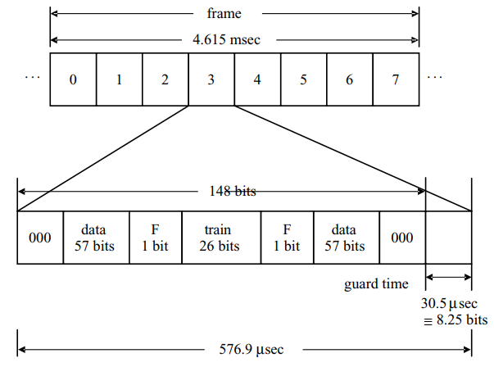
GSM. The structure of a frame and a time slot from a frame

Slide 36
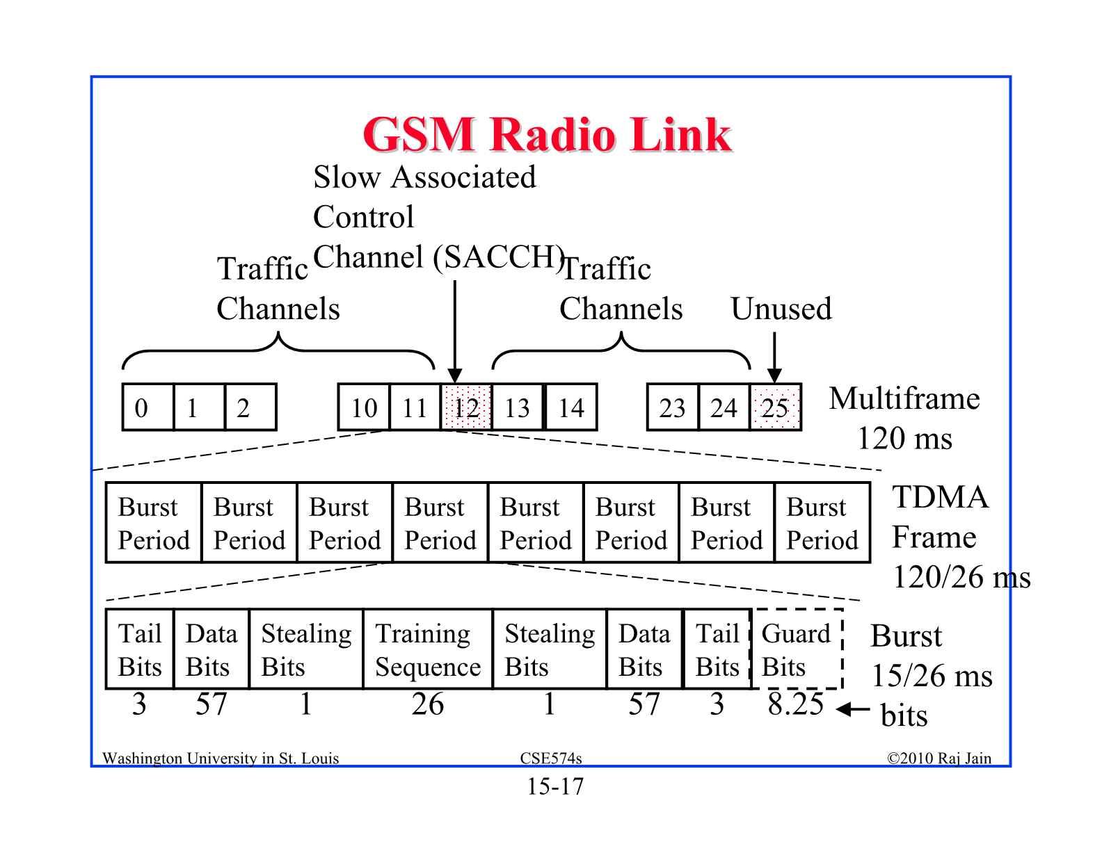
GSM multiframe structure

Slide 37
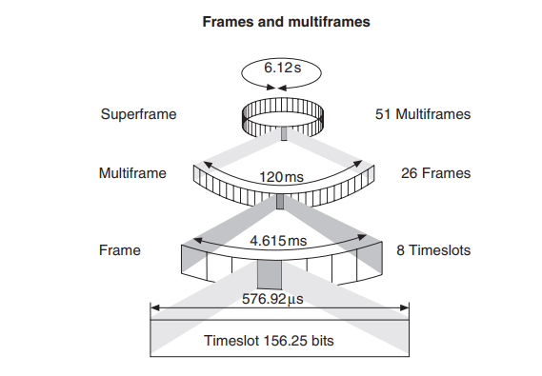
GSM frames, multiframes and superframes

Slide 38
GSM Control Channel
is used to communicate management data (setting up calls, location) between BTS and the cell phone within a GSM cell
only data is exchanged through the control channel (no voice)
a specific frequency from the frequency band allocated to a cell and a specific time slot within this frequency band are allocated for the control channel (beacon frequency); the control channels are logical channels, meaning it is only a message type in a time slot of a frame and this frame occupies a frequency band
GSM control channels can have the following types:
  broadcast control channel (BCCH)
  common control channel (CCCH)
  dedicated control channel (DCCH)

Slide 39
Broadcast Control Channels
type of control channel used for the initial synchronization between the cell phone and the BTS
it is a downlink channel (BTS -> mobile subscriber)
is composed from:
  Frequency Correction Channel (FCCH) – is composed from a sequence of 148 zeros transmitted by the BTS
  Synchronization Channel (SCH) – follows the FCCH and contains BTS identification and location information
  Broadcast Control Channel (BCCH) – contains the frequency allocation information used by cell phones to adjust their frequency to that of the network; is continuously broadcasted by the BTS

Slide 40
Common Control Channels
used for call initiation and setting the MS-BTS connection
is composed of:
  Paging Channel (PCH) – the BTS uses this channel to inform the cell phone about an incoming call; the cell phone periodically monitors this channel (downlink channel: BTS -> mobile subscriber)
  Random Access Channel (RACH) – is an uplink channel used by the cell phone to initiate a call; the cell phone uses this channel only when required; if 2 phones try to access the RACH at the same time, they cause interference and will wait a random time before they try again; once a cell phone correctly accesses the RACH, BTS send an acknowledgement (uplink channel: mobile subscriber -> BTS)
  Access Grant Channel (AGCH) – channel used to set up a call; once the cell phone has used PCH or RACH to receive or initiate a call, it uses AGCH to communicate to the BTS (downlink channel: BTS -> mobile subscriber)

Slide 41
Dedicated Control Channel
control channel used to manage calls
this is a bidirectional channel (these channels/messages can appear in the downlink transmission and also in the uplink transmission)
is comprised from:
  Standalone Dedicated Control Channel (SDCCH) – used to further complete a connection; after the connection is established a traffic channel is assigned to the connection via a SDCCH message
  Slow Associated Control Channel (SACCH) – on the downlink BTS broadcasts messages of the beacon frequency of neighboring cells to the cell phones; on the uplink BTS receives acknowledgement messages, strength and quality of the signal from the cell phone
  Fast Associated Control Channel (FACCH) – used to transmit unscheduled urgent messages; FACCH is faster than SACCH as it can carry 50 messages per second, while SACCH carry only 4.

Slide 42
Traffic Channel
is used to carry voice data
based on the FDMA/TDMA the traffic (voice channel) is divided in 8 different time slots numbered from 0 to 7
the BTS sends signals to a particular cell phone in a specific time slot (from those 8 time slots) and the cell phone replies in a different time slot

Slide 43
Mapping of logical channels over physical channels (downlink path)
almost always non-traffic (i.e. control) channels are mapped on time slot 0 of each frame.
most control channels are repeated in subsequent frames
the interference for downlink logical channels is minimal, but for logical channels that are sent on the uplink stream (MS to BTS), like the RACH (which is used when the mobile subscriber (MS) wants to setup a call) this probability is non negligible
if a collision happens (for example two MS want to setup a call at the same time), the mobile subscribers that caused the collision would sleep a random time before trying again.

Slide 44
Mapping of logical channels over physical channels (downlink path) - detail
Physical channels:
Frame 0
Frame 1
Frame 2
0
1
2
3
4
5
6
7
0
1
2
3
4
5
6
7
0
1
2
3
4
5
6
7
0
1
Logical channels:
FCCH
SCH
BCCH
BCCH
BCCH
BCCH
CCCH0
CCCH0
CCCH0
CCCH0
FCCH
SCH
CCCH1
CCCH1
CCCH1
CCCH1
CCCH2
CCCH2
CCCH2
CCCH2
FCCH
SCH
CCCH3
CCCH3
CCCH3
CCCH3

Slide 45
Mapping of logical channels over physical channels (uplink path)
On the uplink path logical channels like RACH, SDCCH
or SACCH are mapped on the physical channel of time
slot 0 depending on the needs of the mobile
subscriber (e.g. when the mobile subscriber wants to
setup or to receive a call).

Slide 46
GSM Call Processing

Slide 47
Initializing a call
1. when the cell phone is turned on it scans all the available frequencies for the control channel
2. all the BTS in the area transmit the FCCH, SCH and BCCH that contain the BTS identification and location
3. out of available beacon frequencies from the neighboring BTSs, the cell phone chooses the strongest signal
4. based on the FCCH of the strongest signal, the cell phone tunes itself to the frequency of the network
5. the phone send a registration request to the BTS
6. the BTS sends this registration request to the MSC via the BSC
7. the MSC queries the AUC and EIR databases and based on the reply it authenticates the cell phone
8. the MSC also queries the HLR and VLR databases to check whether the cell is in its home area or outside
9. if the cell phone is in its home area the MSC gets all the necessary information from the HLR if it is not in its home area, the VLR gets the information from the corresponding HLR via MSCs
10. then the cell phone is ready to receive or make calls.

Slide 48
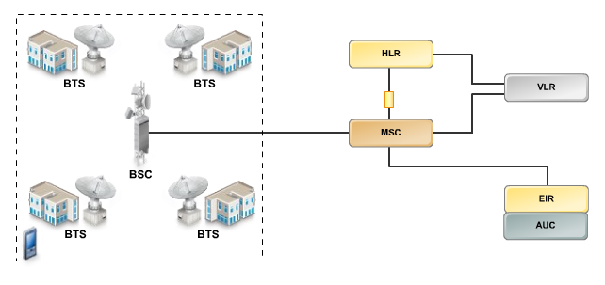
Initializing a call (2)

Slide 49
Making a call
1. when the phone needs to make a call it sends an access request (containing phone identification, number) using RACH to the BTS; if another cell phone tries to send an access request at the same time the messages might get corrupted, in this case both cell phones wait a random time interval before trying to send again
2. then the BTS authenticates the cell phone and sends an acknowledgement to the cell phone (grants MS access to an SDCCH via the AGCH)
3. the BTS transmits the request to the MSC via BSC using SDCCH
4. the MSC queries HLR and VLR and based on the information obtained it routes the call to the receiver’s BSC and BTS
5. MSC orders BSC and BTS to associate a free TCH (traffic channel) with this connection (i.e. a time slot and carrier frequency)
6. the cell phone uses the voice channel and time slot assigned to it by the BTS to communicate with the receiver

Slide 50
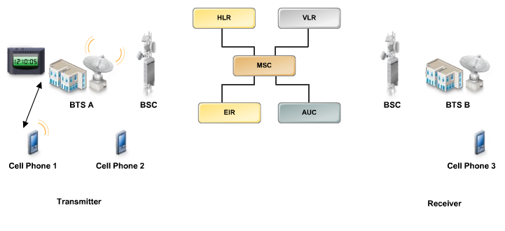
Making a call (2)

Slide 51
Receiving a call
1. when a request to deliver a call is made in the network, the MSC or the receiver’s home area queries the HLR; if the cell phone is located in its home area the call is transferred to the receiver; if the cell phone is located outside its home area, the HLR maintains a record of the VLR attached to the cell phone
2. based on this record, the MSC notes the location of the VLR and indicated the corresponding BSC about the incoming call
3. the BSC routes the call to the particular BTS which uses the paging channel to alert the phone
4. the receiver cell phone monitors the paging channel periodically and once it receives the call alert from the BTS it responds to the BTS
5. the BTS communicates a channel and a time slot for the cell phone to communicate
6. now the call is established

Slide 52
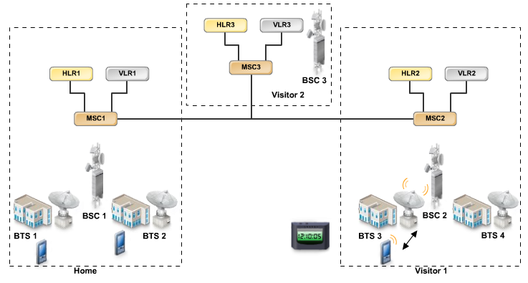
Receiving a call (2)

Slide 53
GSM Security
Personal Identification Number (PIN)
User Authentication
Confidentiality (data encryption)

Slide 54
Personal Identification Number (PIN)
the PIN is stored on the SIM card of the cell phone
when the cell phone is turned on, the SIM checks the PIN; in case of 3 consecutive faulty PIN inputs a PUK (Personal Unblocking Key) is asked for
in case of 10 faulty PUK inputs, the SIM is locked and the subscriber must ask a new SIM
this security measure is within the cell phone and the service provider is not involved

Slide 55
User Authentication
when the MS first accesses the network or when it starts a call or receives a call it is authenticated by the AuC
the AuC sends random data to the cell phone (RAND)
each cell phone is allocated a secret key (KI) stored on the SIM card
using RAND and KI and the A3 encryption algorithm the cell phone generates a signed result (SRES) which is then sent to the network
a similar process takes place in the AuC which generates a signed result specific to the cell phone
the network compares its SRES with the SRES generated by the phone and in case of a match the cell phone is connected to the network

Slide 56
Data encryption (confidentiality)
all user conversations between MS and BTS (voice and data) is encrypted using an algorithm A5
there are 7 versions of the A5 algorithms, most of them secret, some of them reversed engineered
in A5/1, the key stored by the SIM and the random number produced by the AuC (for the authentication process) are passed through an A8 key generation algorithm (the A8 algorithm is stored on the SIM) which produces a 64bit chipering key K.
the A5/1 algorithm takes the 64bit key K and a 22-bit long representation of the TDMA frame number and produces two 114-bit long encryption streams (one for the uplink transmission and the other for the downlink transmission) which are then XORed with the 114 bits of the user in a burst prior to modulation.

Slide 57
The A5/1 encryption algorithm
A5/1 produces the two 114-bit encryption streams by using 3 linear feedback shift registers (LFSRs)
an LFSR is a shift register whose input is a linear function of its previous state
the register’s state is decided by several tap-bits, and the linear feedback function is an XOR of all the register’s tap bits

Slide 58
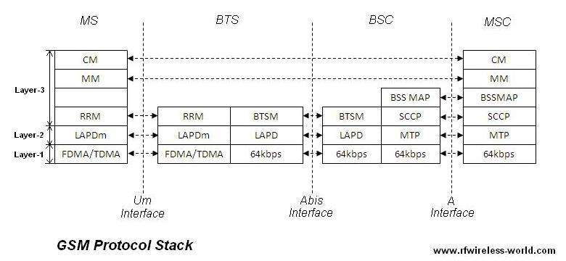
GSM protocol stack

Slide 59
GSM protocol stack (details)
Physical layer (layer 1) : FDMA/TDMA is used between the MS and BTS, but from BTS to the rest (BSC,MSC), the data is represented digital on 64kbps on the wire
Layer 2: protocols LAPD,LAPDm; functions:
  Establish, maintain, tear down the datalink
  Flow control
  Error detection
Maximum LAPDm frame length is 23 bytes, i.e. 184 bits
LAPDm frame fields:
  Address field (8 bits)
  Control field (8 bits)
  Frame length (8 bits)
  Signalling data (23 bytes)
  Payload data
  Layer 3: includes signalling protocols:
  - Radio Resource Management (RR) – manages the allocation of radio traffic channels to MS
  - Mobility Management (MM)
  - Connection Management (CM)

Slide 60
4G LTE (Long Term Evolution) and LTE-Advanced

Slide 61
About LTE and LTE-Advanced
LTE and LTE-Advanced are two standards produced by 3GPP (3rd Generation Partnership Project)
LTE is not truly 4G because it does not respect the ITU-R’s requirements for 4G - International Mobile Telecommunications Advanced (IMT-Advanced), but it is marketed as one
LTE-Advanced is a candidate of 4G
ITU-R IMT-Advanced (i.e. 4G) requirements are: 100 Mbps speed for high mobility setups (cars and trains) and 1Gbps for low mobility (pedestrians)
another 4G candidate is IEEE 802.16m or WirelessMAN-Advanced

Slide 62
LTE characteristics
It is based on Universal Mobile Telecommunication System (UMTS) system
All interfaces between network nodes are IP based
Devices support MIMO (Multiple Input Multiple Output) transmissions (the BTS can transmit several data streams over the same carrier simultaneously)

Slide 63
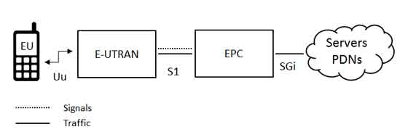
High level network architecture of LTE
The User Equipment (UE) – similar to the mobile equipment used in GSM
The Evolved UMTS Terrestrial Radio Access Network (E-UTRAN).
The Evolved Packet Core (EPC).

Slide 64
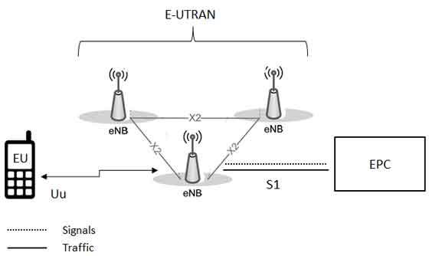
The E-UTRAN (access network)

Slide 65
The E-UTRAN (details)
Handles the connection between the UE (i.e. mobile phone) and the EPC
Is formed by evolved base stations (eNB)
Is connected to the EPC through the S1 interface
An eNB can be connected to other eNBs through the X2 interface

Slide 66
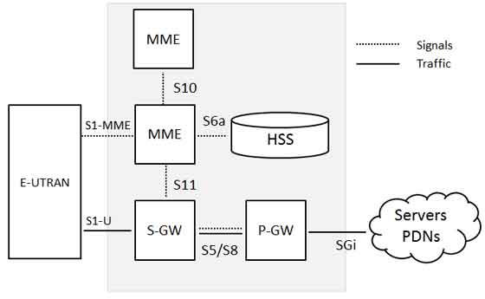
The EPC (Evolved Packet Core) network

Slide 67
Evolved Packet Core details
HSS (Home Subscriber Server) – is just a database of all subscribers of the network with details for those subscribers
P-GW (Packet Data Network Gateway) – links the cellular network with other networks (e.g. IP networks like the Internet); IP address allocation for UE, QoS enforcement on flows
S-GW (Serving Gateway) – a router that forwards IP packets between eNBs and P-GW
MME (Mobile Management Entity) – controls the high level operations of the cellular network (Non-Access Stratum. NAS, protocols)

Slide 68
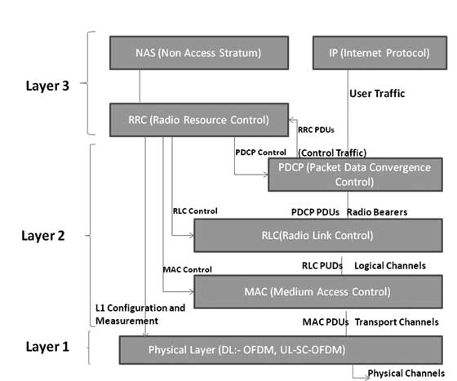
LTE Protocol Layers (general)

Slide 69
LTE Protocol Layers (details)
The Physical layer provides modulation over electromagnetic waves
MAC (Medium Access Control) groups logical channels in transport blocks which are then mapped over physical transport channels
RLC (Radio Link Control) – transfers upper PDUs (Protocol Data Unit) from upper layers to MAC; it also deals with error correction, segmentation/assembly, ARQ (Automatic Repeat Request) – if packet is not acknowledged by receiver, it is automatically retransmitted
PDCP (Packet Data Convergence Protocol) – deals with IP header compression/decompression, data encryption, in sequence delivery of packets to upper layers
RRC (Radio Resource Control) - establish, release and management of connections between the UE and eNBs

Slide 70
LTE Protocol stack above IP level
The S1 network interface that connects eNB to EPC is split into: control plane and the user plane
On the control plane, packets use SCTP (Stream Control Transmission Protocol) on top of IP
On the user plane, packets use GTP-U (GPRS Tunneling Protocol User plane) on top of UDP which is on top of IP
Below IP, there are the layer 2 and layer 1 protocols presented on the previous slide (OFDM, MAC, RLC, PDCP).

Slide 71
Logical channels
like in GSM, logical channels define the message type
There are control channels and traffic channels
Common control channels are used for controlling multiple subscribers, dedicated control channels are used for controlling only one subscriber
Control channel examples: Broadcast Control Channel (BCCH), Paging Control Channel (PCCH), Common Control Channel (CCCH), Dedicated Control Channel (DCCH), Multicast Control Channel (MCCH), Dedicated Traffic Channel (DTCH), Multicast Traffic Channel (MTCH)

Slide 72
Transport channels
Transport channels define the message type between the MAC and the physical layer
Examples of transport channels:
  Broadcast Channel (BCH)
  Downlink Shared Channel (DL-SCH)
  Paging Channel (PCH)
  Multicast Channel (MCH)
  Uplink Shared Channel (UL-SCH)
  Random Access Channel (RACH)

Slide 73
Physical channels
They are physical data channels and physical control channels
They define the modulation of binary data on radio waves
OFDM (Orthogonal Frequency-Division Multiplexing) is used for modulation
From the binary data of the transport channel blocks a symbol ready to be transmitted over air is formed
Symbols are grouped into resource blocks
When transmitted (modulated) a data symbols are spread over several resource blocks
A resource block occupies one 180KHz subcarrier and a 0.5ms time slot
Examples:
  PDSCH - Physical Downlink Shared Channel; used to carry high speed data/multimedia
  PDCCH - Physical Downlink Control Channel; used to carry UE specific control information.
  CCPCH - Common Control Physical Channel; carries cell-wide control information.

Slide 74
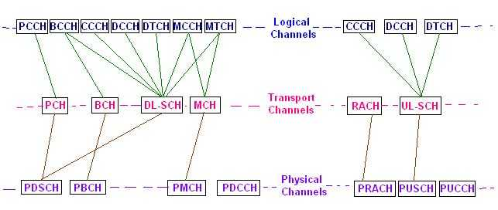
Logical chan. -> Transport chan. -> Physical chan.
https://www.rfwireless-world.com/

